Slide 1
God does play dice
with the universe
A DIGITAL TWIN OF THE WAVESHARE JETBOT
What a simulated robot gets right, what it cannot, and what the real one taught us about the difference.
Muthuphei Mukhunyeledzi
Notes:
Open with the title: Einstein said God does not play dice. A sixty-dollar robot on a tiled floor disagrees. This talk is about building a twin of that robot, showing the three objectives were met, and then being honest about where a simulation and a real machine part ways.

Slide 2
Three objectives
THE BRIEF
1 · Circuit
2 · Geometry
3 · Twin
Design the circuit before buying parts
Know the parts fit before making them
Compare the twin with the real robot
elecsim, a framework anyone can clone to define their own parts and constraints.
A 3D model that refuses to build if one part passes through another.
Ten experiments on the real JetBot, with predictions saved first.
Notes:
The research moved from a RoboCup robot we could not order parts for, to a JetBot that was already on the bench. That made the question sharper: a twin of a real robot can be checked. The first two objectives are quick to show. Most of the talk is the third, because that is where the surprises were.

Slide 3
A circuit is a Python file
ELECSIM
c = Circuit("torch")
cell = c.add(Cell("cell", r0=assumed(0.06)))
sw = c.add(Switch("sw", i_max=1.0))
lamp = c.add(Resistor("lamp", r=6.0))
c.connect("BAT", cell.p, sw.a)
c.require("lamp gets at least 2 W", ...)
Notes:
A part is a class: declare its pins and numbers, write its equations. The library has cells, regulators, motors, H-bridges, the PWM chip and the measurement chips. The JetBot's board is one design written with it; the framework itself knows nothing about the JetBot. It also runs fault analysis: every open and short applied in turn. 60 tests pass.

Slide 4
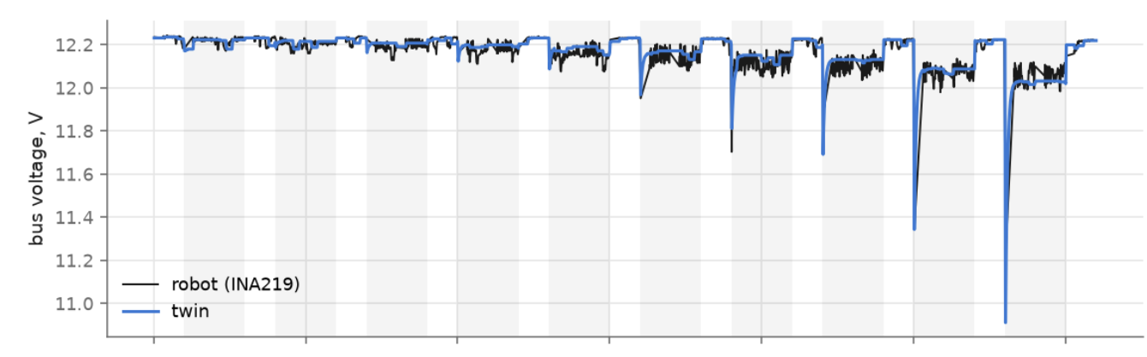
ELECSIM
Notes:
A part is a class: declare its pins and numbers, write its equations. The library has cells, regulators, motors, H-bridges, the PWM chip and the measurement chips. The JetBot's board is one design written with it; the framework itself knows nothing about the JetBot. It also runs fault analysis: every open and short applied in turn. 60 tests pass.

Slide 5
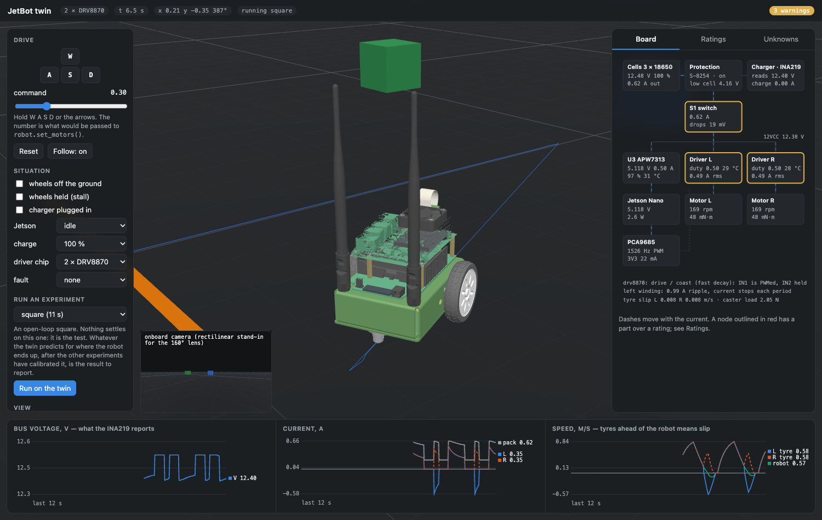
Know the parts fit before making them
OBJECTIVE 2
Notes:
The geometry is the manufacturer's own CAD, plus three things added by hand: the hinged camera mount, the battery cells, and the ribbon cable. The mount took six attempts from photographs: once it passed through the circuit boards, once the ribbon ended in mid-air. Each mistake became a check. Limits to state if asked: the checks test the added parts against everything else, not the manufacturer's parts against each other, and printing a part from the model is the test still to do.

Slide 6
OBJECTIVE 3 · TWIN AGAINST ROBOT
Notes:
The robot has no sensor for wheel speed, position or heading, so everything here was measured from outside: slow-motion video of tape on the wheel hub, a top-down video for heading, and the 50 cm floor tiles as the ruler. The circuit and the dynamics are stepped together, driven by the same register writes as the real robot.

Slide 7
Where the dice come from
MEASURED ON THIS ROBOT
Other dice, on any robot | Typical spread | Basis
Motor constant, unit to unit | ±10 % | datasheet
Winding resistance when hot | +20 % at +50 °C | physics
Tyre grip on the floor | ±30 % | rule of thumb
Camera-to-action delay | 30–150 ms | rule of thumb
Gearbox backlash | 1–3° | datasheet
Gyro offset, uncalibrated | up to ±20 °/s | datasheet
Mass and balance vs CAD | ±5–10 % | rule of thumb
The two motors are not equal
About 2.6 % apart: driving "straight", the robot drifted over 25 cm sideways in 1.47 m.
The battery is not one number
Cell resistance was 0.058 Ω charged and 0.125 Ω nearly flat: double.
Typical figures for small robots, not measured on this one. The basis column says how far to trust each.
Notes:
None of these are exotic. Timing: a motor command is fourteen separate writes over I2C from Python; once we fixed our own agent the spread in duration fell to about 2 ms, but the ordinary library has the jitter. Mismatch: a strip of tape left on one tyre hid this for half the tests; removing it reversed the drift. History: candidates are gearbox backlash and leftover motion after braking; we have not separated them. Even a strip of tape on a tyre changed which way the robot drifted.

Slide 8
Could the robot learn to drive inside its twin?
THE BIGGER QUESTION
Training in simulation is fast, safe and resets for free. It only pays off if what is learned there still works on the floor.
Notes:
This is where the project points next. The JetBot is normally taught collision avoidance by driving it by hand and collecting photos. With a twin you could do that in simulation: thousands of runs, no crashes, no manual resets. The catch has a name, the sim-to-real gap or reality gap: a controller trained in a clean simulation often fails on the real machine. The last few slides showed that gap, measured, on our own robot. The next slides are four ideas for dealing with it.

Slide 9
Every simulator makes the same bets
BEYOND THIS TWIN
A simulator assumes | This robot showed
A command acts when it is sent | Up to 72 ms late, different every time
Two identical motors | 2.6 % apart
One friction value per surface | No single value fits both a short turn and a long spin
The same action gives the same result | ±8° on a quarter-turn, ±23° after driving
The field's answer is to stop chasing one exact world and train across the spread instead. To do that, someone has to measure the spread.
Notes:
This is the sim-to-real gap that larger simulators face too: they idealise contact, actuation delay and sensors. The usual remedy, domain randomisation, trains a controller over many randomly varied simulated robots so the real one is just one more variation. Our twin already does a small version: its predictions come from 40 robots drawn across its uncertain numbers. The numbers on this slide are what the randomisation ranges should be for this robot, rather than guesses.

Slide 10

Make the robot behave like the twin
IDEA 2 · FEEDBACK CONTROL
A twin gives an illusion of perfection. Feedback is what lets real hardware live up to it.
Planner or twin
Asks for a speed, not a motor voltage
Source of error | Feedback hides it?
Battery sag | Yes
Unequal motors | Yes
Changing floor friction | Yes
Wheels slipping on the floor | No
Feedback loop (PID)
Measures the wheel, corrects the drive
Motors and wheels
Unequal, sagging, never the same twice
Notes:
The idea in one line: instead of making the twin as messy as the robot, put a feedback loop at the bottom so the robot is as tidy as the twin. The planner asks for half a metre per second; the loop measures the wheel and adjusts the drive until that is what happens, whatever the battery or the weaker motor is doing. Three of the dice we measured, battery, mismatch and friction, are exactly what such a loop absorbs. It cannot see wheel slip, because it measures the wheel and not the ground. And it needs a sensor, which is the next slide.

Slide 11


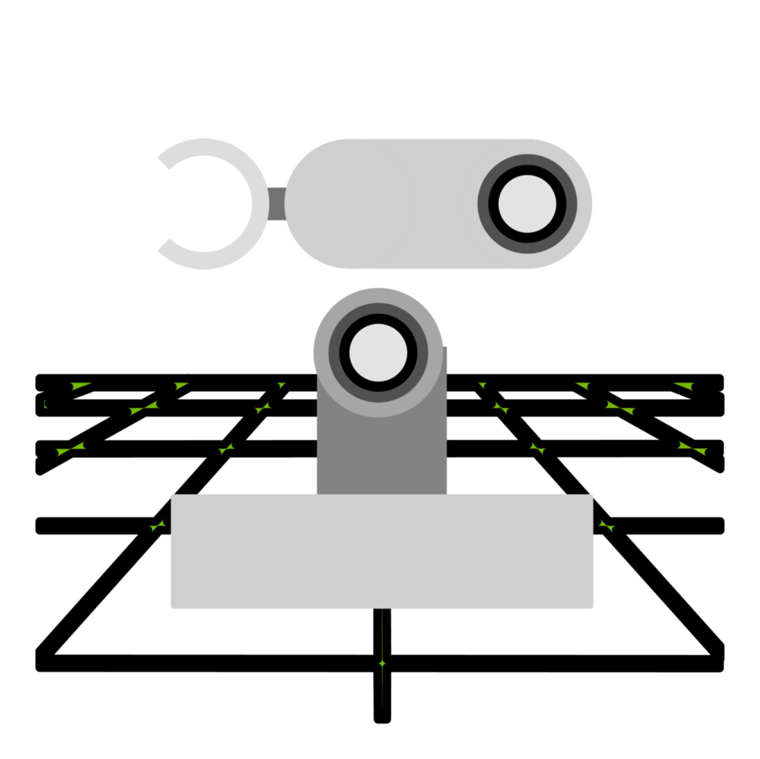



Is the human in the loop the problem?
IDEA 4 · LEARNED WORLD MODELS
RULES WRITTEN BY HAND
RULES LEARNED FROM DATA
Chess
Genie 3
Every rule fixed and written down
Generates playable worlds from a prompt
Isaac Sim
Cosmos
NVIDIA’s physics simulator for robots
World foundation models for robots and vehicles
Webots
V-JEPA 2
Open-source robot simulator
Learns to predict from video, then plans robot actions
Notes:
The provocative version: every gap we found was a human assumption. Identical motors, one friction number, commands that arrive on time. So let the machine build its own model of the world from what it does and sees, with no equations from us. That is the idea behind learned world models, an active research direction. Our evidence cuts both ways. For it: no single hand-written friction value could fit both the short turn and the long spin. Against it: a written model predicted the robot from a schematic before it was powered, and told us a 5 volt rail was in trouble; a learned model cannot do that for a robot that does not exist yet. And learning needs a great deal of real driving. This is a discussion slide, not a result.

Slide 12
The price is not worth the prize
Notes:
The provocative version: every gap we found was a human assumption. Identical motors, one friction number, commands that arrive on time. So let the machine build its own model of the world from what it does and sees, with no equations from us. That is the idea behind learned world models, an active research direction. Our evidence cuts both ways. For it: no single hand-written friction value could fit both the short turn and the long spin. Against it: a written model predicted the robot from a schematic before it was powered, and told us a 5 volt rail was in trouble; a learned model cannot do that for a robot that does not exist yet. And learning needs a great deal of real driving. This is a discussion slide, not a result.

Slide 13
“Can we do better?”
- Dr Richard Klein
Notes:
The provocative version: every gap we found was a human assumption. Identical motors, one friction number, commands that arrive on time. So let the machine build its own model of the world from what it does and sees, with no equations from us. That is the idea behind learned world models, an active research direction. Our evidence cuts both ways. For it: no single hand-written friction value could fit both the short turn and the long spin. Against it: a written model predicted the robot from a schematic before it was powered, and told us a 5 volt rail was in trouble; a learned model cannot do that for a robot that does not exist yet. And learning needs a great deal of real driving. This is a discussion slide, not a result.

Slide 14


